Slide 1
Module 3: Make model-driven apps with Power Apps

Slide 2
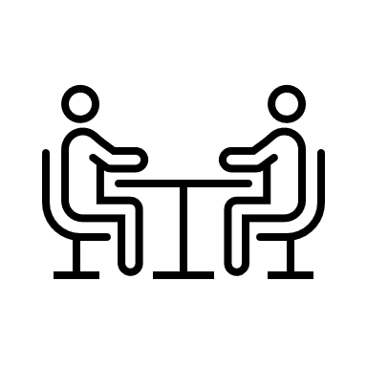
What kind of apps have you made or used?

Slide 3
Types of Power Apps
Model-driven
Canvas
Portal
Targets internal facing users
Designed around the data
Powered by Dataverse
Automation
Customizable user experience
Customizable with or without professional developers
Targets internal facing users
Designed around the user experience
Connect to hundreds of data sources
Automation
Customizable with or without professional developers
Targets external stakeholders
Public-facing website
Powered by Dataverse
Customizable with or without professional developers

Slide 4
Model-driven Power Apps
Building blocks of model-driven apps
Design model-driven apps
Forms and views

Slide 5
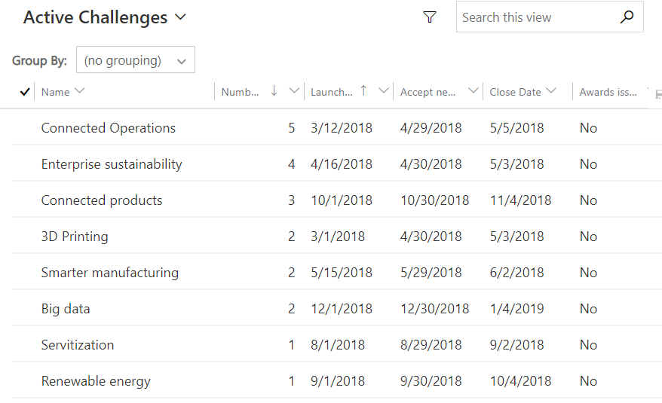
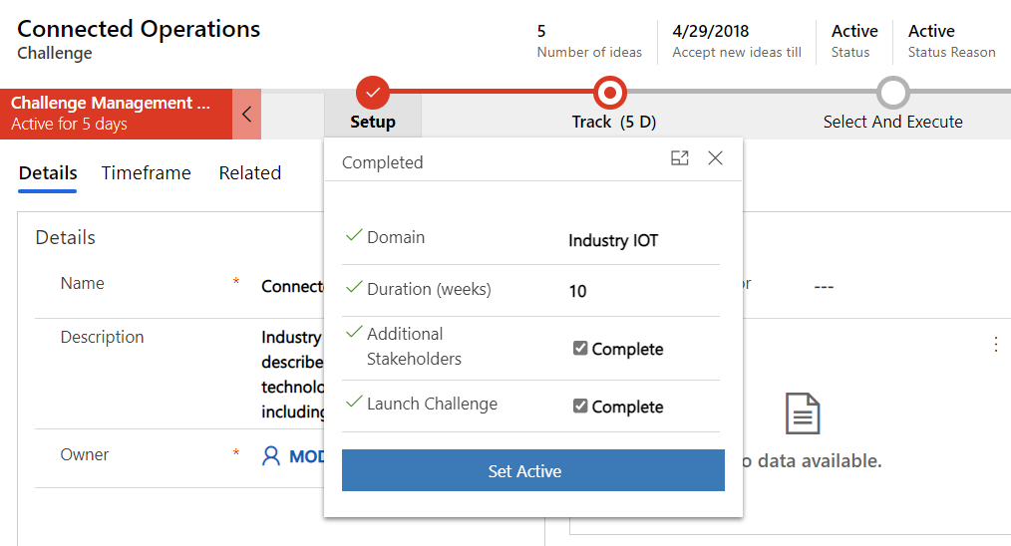
Model-driven apps
List and forms over data
Consistent experience across apps and devices
Easy to build with configuration first approach
Model-driven apps require Microsoft Dataverse
You can build more than one model-driven app from a single Dataverse environment
Notes:
Start Time xx:xx / Length: 2 minutes
Review the learning objectives.

Slide 6
Built-in to all model-driven apps
Advanced Find
Searching
Personal Views
Personal Dashboards
Editable Grids
Excel Integration
Client Dev Extensibility
Client side Business Rules
Reusable Quick View Forms
Business Process Control
Timeline Activity View
Command Bar Extensibility
Duplicate Detection
Multiple Makers
Recently Viewed/Pinned
Localization support

Slide 7
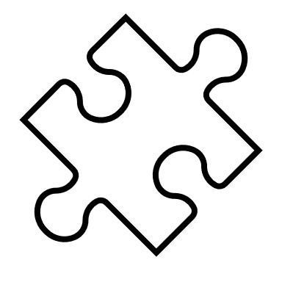
Demo

Slide 8
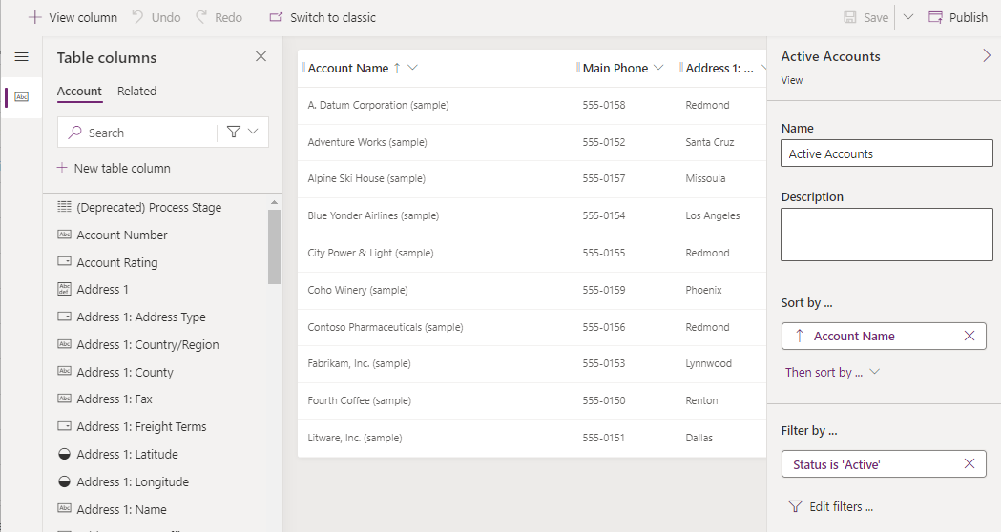
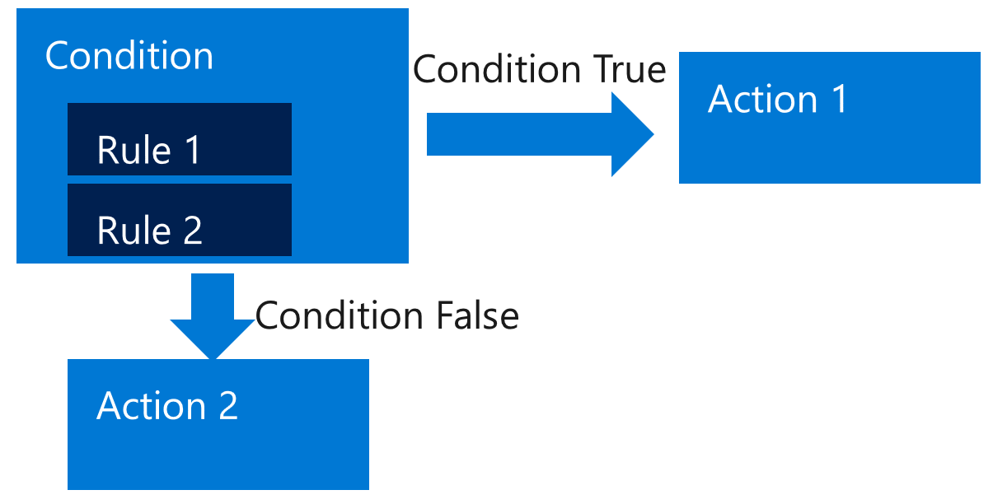
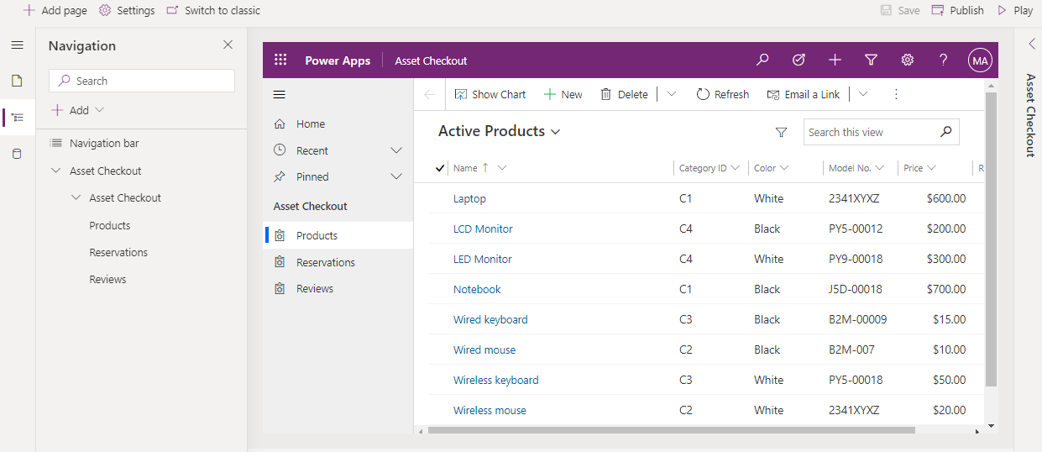
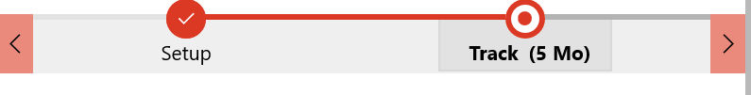
Build your model-driven app
Build the Data Model
Create Forms, Views and Dashboards
Compose the App
Build Business Rules
Build Process Flows
Permit
Inspections
Notes
Plans
Building Owners

Slide 9
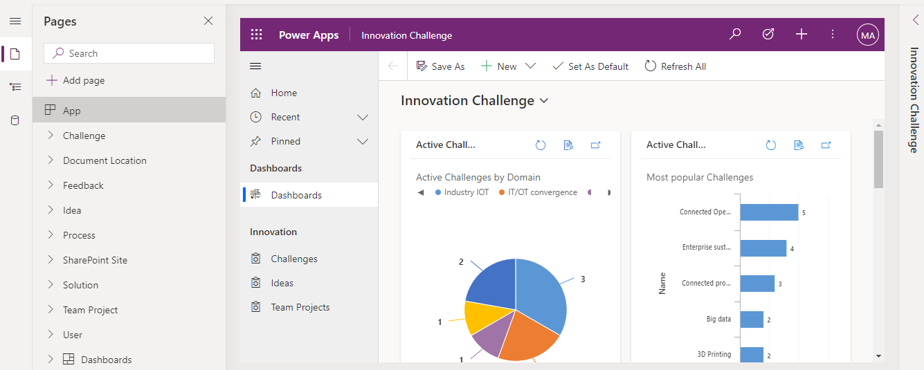
Build the app
After modeling data and defining processes, you build your app by selecting and setting up the components you need in the App Designer.

Slide 10
User interface
Component | Description | Designer
App | Apps determine the app fundamentals, like components, properties, the client type, and the URL. | App designer
Site map | A site map specifies the navigation for your app. | Site map designer
Form | Forms include a set of data entry columns for a given table. This set of data entry columns matches the items that your organization tracks for the table. One example is a set of data entry columns where users enter relevant information to track a customer's previous orders together with specific requested reorder dates. | Form designer
View | Views define how a list of records for a specific table appears in your app. A view defines the columns shown, the width of each column, the sort behavior, and the default filters. | View designer
Embedded apps | Add a canvas app to your model-driven app form or dashboard | Model-driven app designer/canvas designer
Custom page | This preview feature allows you to add a single custom (canvas) page to a model-driven app | Model-driven app designer/canvas designer

Slide 11
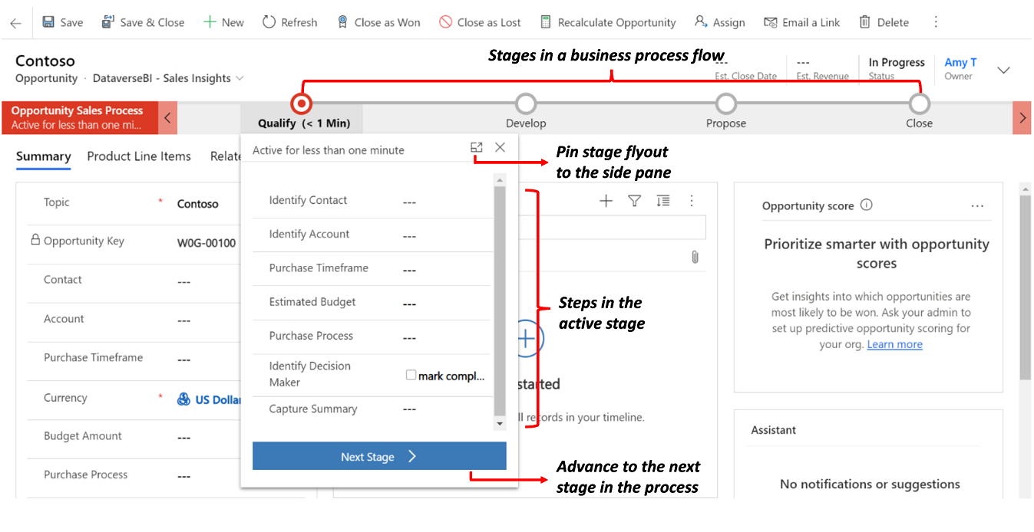
Logic
The logic components determine what business processes, rules, and automation the app will have.
Types of logic
Business process flow
Workflow
Actions
Business rule
Cloud flows

Slide 12
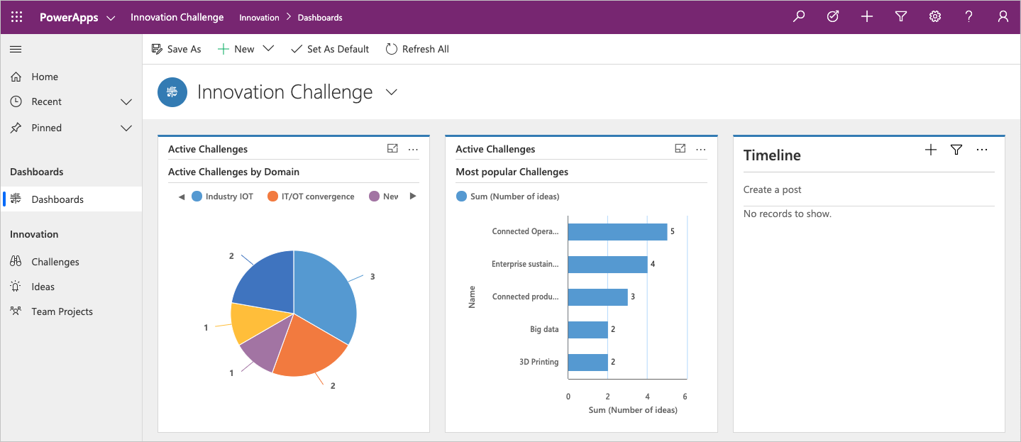
Visualization
Component | Description | Designer
Chart | Charts are individual graphical visualizations that can appear in a view or a form or that can be added to a dashboard. | Chart designer
Dashboard | Dashboards show one or more graphical visualizations that provide an overview of actionable business data. | Dashboard designer
Embedded Microsoft Power BI | Power BI adds embedded Power BI tiles and dashboards to your app. Power BI is a cloud-based service that provides business intelligence (BI) insight. | A combination of chart designer, dashboard designer, and Power BI

Slide 13
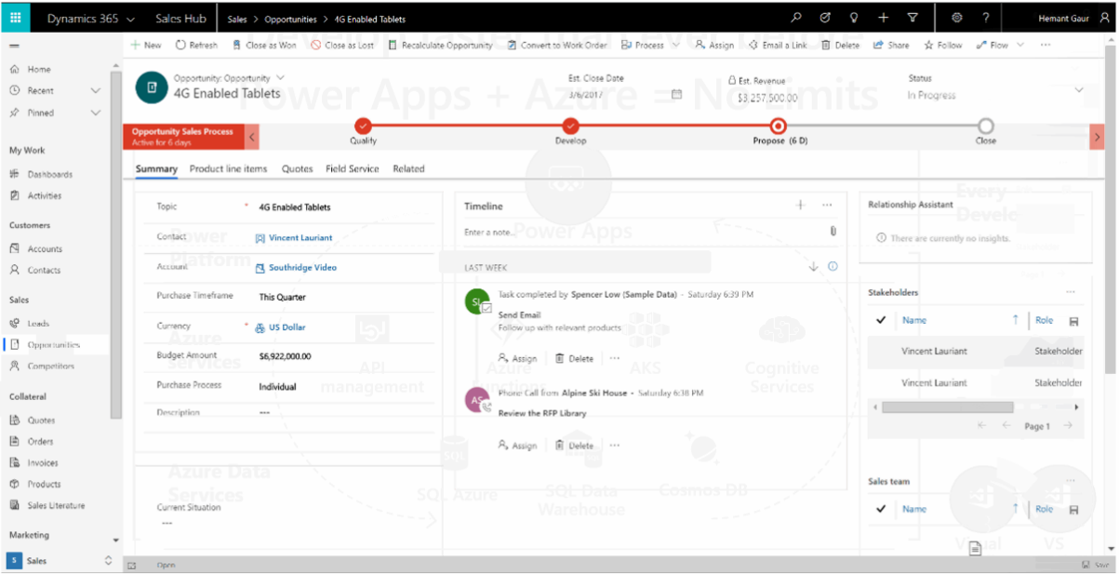
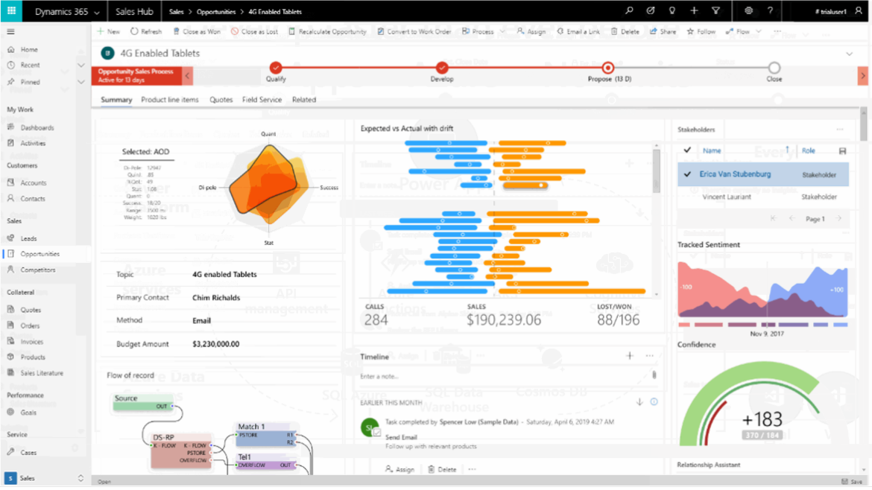
Power Apps Component Framework
Code components can be used to enhance the user experience for users working with data on forms, views, dashboards, and canvas app screens

Slide 14
Demo https://pcf.gallery/

Slide 15
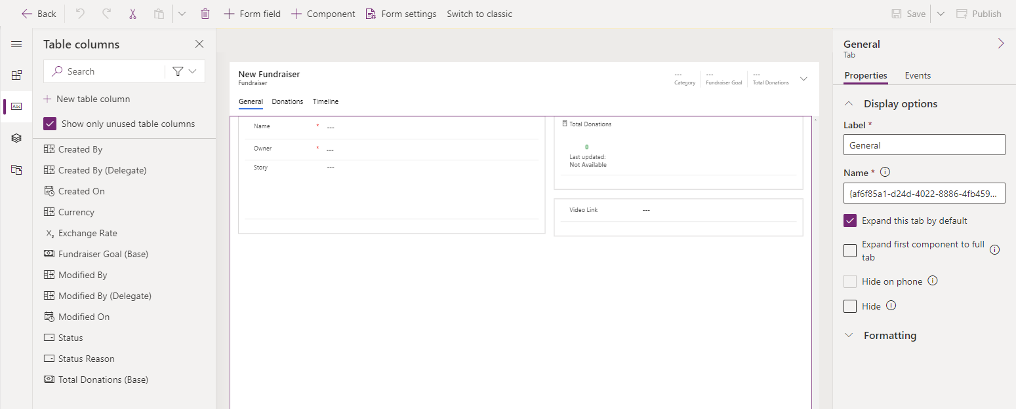
User Interface (UI) and User Experience (UX)
When building a model-driven app, some of the UI and UX are predetermined for you, but customizable.

Slide 16
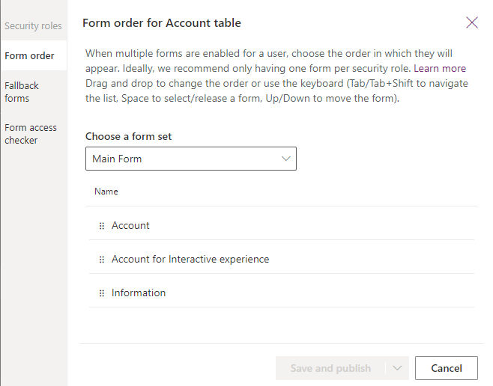
Configure multiple forms
Users of model driven applications will encounter many forms in their user experience, and will even encounter different forms for the same table depending on their role, job tasks and desired outcomes.
You can create more than one Quick Create form for a given table, but only the first one in order will be available for end users.

Slide 17
Demo

Slide 18
Access to forms
When users need to access common tables for different roles, it might be useful to have other forms available to tailor the user experience for that particular set of users.
Controlling user access to forms is not necessarily a secure means to prevent access to data. Sometimes users have other ways to interact with data such as advanced find or background automation.

Slide 19
Miscellaneous form details
Each table must have a designated fallback form. This is the form that all users would see if they do not have a security role assigned that matches your role tailored forms.
Only Main forms can be assigned to security roles.
When a user has access to multiple forms, a form selector will be available near the top of the form. If a user has access to only a single form for a given table, there will be no form selector visible.
You can designate a main form as inactive. This will make it not visible to all users, regardless of security roles. This feature was included primarily to manage new forms included when organizations upgrade but you can use it to prevent people from being able to use any main form.
The table definition must allow for Quick Create before you will be able to configure a Quick Create form. This setting is managed along with other Data Services for the table.

Slide 20
Module 3 practice labs
Lab 3.1: Use app designer
Lab 3.2: Modify forms
Lab 3.3: Modify views

Slide 21
Summary
Model-driven app design is an approach that focuses on quickly adding components to apps. These components include dashboards, forms, views, and charts.
Little or no code is required to build model-driven apps.
Model-driven design uses metadata-driven architecture so that designers can customize their apps.

Slide 22
Closing slide

